Slide 1
H
H
O
roots ➔ stem
stem ➔ leaf
evaporates
through stomata
5

Slide 2
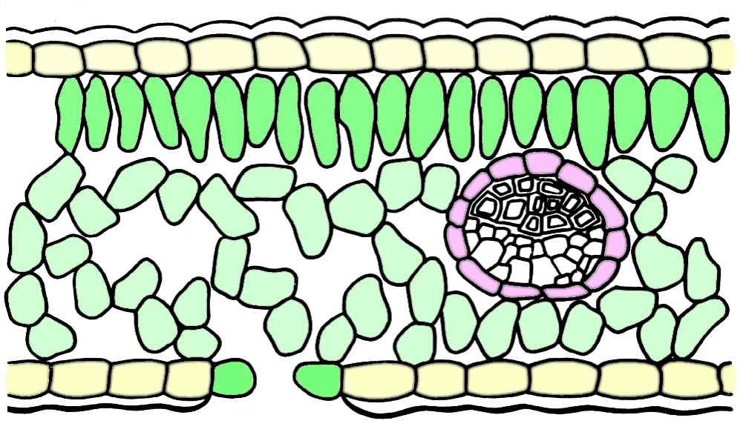
spongy mesophyll cells
upper epidermal cells
lower epidermal cells
vascular tissue (vein)
upper epidermis
lower epidermis
palisade cells
chloroplasts
guard cells
mesophyll
air space
Identify.
stomata
cuticle
4
5
1
6
7
2
8
9
10
11
3
12
13
14

Slide 3
The evaporation of water from leaves through the stomates is
transpiration.
7

Slide 4
Water moves up a continuous column of hollow cells called
xylem
xylem
xylem.
xylem
Xylem tissue runs continuously from roots ➔ stems ➔ leaves.
xylem
10

Slide 5
Cohesion and adhesion
are two of several factors that help regulate the movement of water through a plant.
11

Slide 6
Because a water molecule is polar, it can attract like and unlike molecules.
+
+
H
H
O
_
Water sticking to water is cohesion, the attraction of like molecules to each other.
+
H
+
+
O
_
cohesion, the attraction of like molecules to each other.
H
_
+
H
O
H
+
H
_
O
H
O
O
H
+
+
H
_
_
H
H
+
+
+
12

Slide 7
KEY POINT
Energy is transformed from one form to another

Slide 8
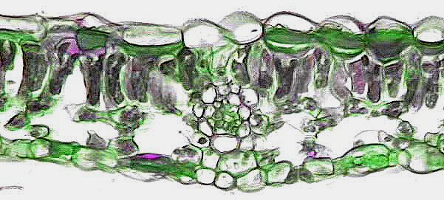
Photosynthesis
occurs in chloroplasts
occurs in 3 cells containing chloroplasts:
palisade cells, spongy cells, guard cells

Slide 9
Photosynthesis
uses
results in
raw materials
products
include
include
water
carbon dioxide
glucose
water
oxygen

Slide 10


CO₂
CO₂
O
CO₂
O
O
H₂
H₂
H₂
CO₂
O
H₂O
H₂
O
CO
CO
CO
CO
H⁺
CO
CO
H⁺
CO
CO
CO
CO
O
+
+
+
H₂O
O₂
H⁺
sugar
sugar
sugar
Notes:
Water enters the leaf through vascular tissue called xylem.
Chloroplasts capture radiant energy from the sun, and use it to split water molecules into H (hydrogen) and O (oxygen).
Hydrogen combines with carbon dioxide (?) to form glucose, a sugar the plant uses for food.
Glucose is transported through the vascular tissue called phloem from the leaves to the rest of the plant.

Slide 11
The process of photosynthesis can be represented in a chemical equation.
6CO₂ +
6H₂O
chlorophyll
C₆H₁₂O₆ +
6O₂↑
raw materials
products

Slide 12


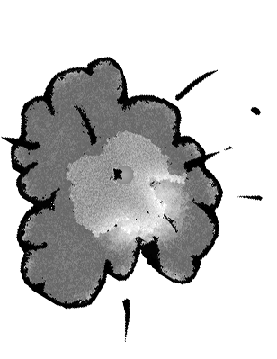
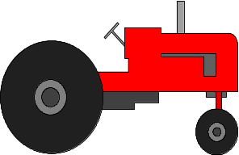


CO₂
CO₂
CO₂
CO₂
CO₂
CO₂
CO₂
CO₂
CO₂
CO₂
CO₂
CO₂
CO₂
CO₂
CO₂
CO₂
CO₂
C
19

Slide 13
The Green house affect is when (answer is on next slide)

Slide 14
transparent gases in the atmosphere
including CO₂, CH₄ (methane), nitrous oxide, chlorofluorocarbons (CFCs), and water vapor
trap heat near the Earth’s surface
What are
greenhouse
gases?
can raise the mean global temperature of the Earth
C

Slide 15

Plants convert sugar to starch for short-term and long-term storage.
sugar
Starch molecules tend to cluster in certain plant cells.

Slide 16
Carbon is found in 4 large areas called reservoirs or sinks.
atmosphere
carbon reservoir
biosphere
Where is
carbon found?
carbon reservoir
oceans
carbon reservoir
sediments
carbon reservoir
6

Slide 17

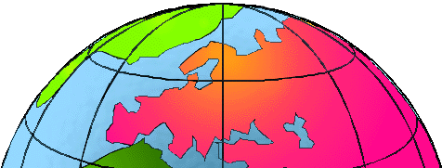
changes in the Earth’s atmosphere that may enhance the natural warming process and elevate global temperature
Most outgoing heat energy: trapped
CO₂
CO₂
blanket of carbon dioxide and other greenhouse gases
CO₂
CO₂
CO₂
CO₂
CO₂
CO₂
CO₂
CO₂
CO₂
CO₂
What is the
greenhouse
effect?
CO₂
CO₂
CO₂
CO₂
CO₂
CO₂
CO₂
CO₂
CO₂
CO₂
C
CO₂
CO₂
CO₂

